Slide 1



PATIENT HEALTH RISK STRATIFICATION
-Team Members:
Sharon Swetha X
Shunmathi D
Sandhya G
Shubham Raj
CAPSTONE PROJECT PRESENTATION

Slide 2


Agenda
Introduction
Problem Statement
Data and Methodology
K-Means Clustering
Clustering Analysis
Result and Conclusion

Slide 3

INTRODUCTION
Objective: To identify patient risk groups for personalized healthcare interventions by clustering using k-Means
Importance: Improve patient outcomes, optimize resource allocation, and reduce healthcare costs

Slide 4
PROBLEM STATEMENT
●Using clustering algorithm to stratify patients into different risk categories based on :
Health records
Lifestyle factors
Previous healthcare interactions
●Identify high-risk group who can benefit from:
Preventive care
Close monitoring
Targeted intervention programs.
●Aim: Cluster the patients based on categories to help get better use of healthcare resources.

Slide 5

Data & Methodology
Description of dataset: Patient demographics, medical history, and risk factors
Pre-processing steps:
Handling missing values
Feature selection
Data standardization

Slide 6
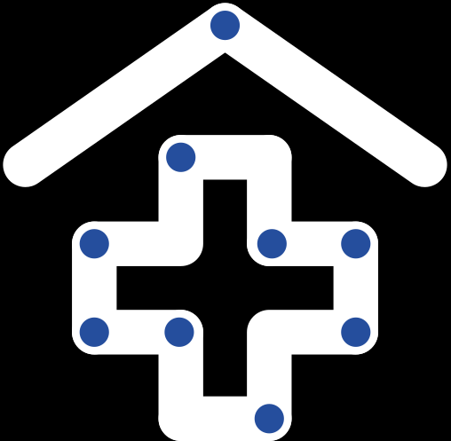
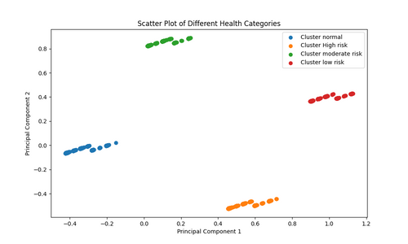
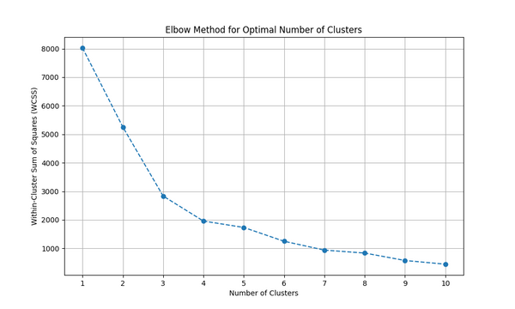
K-Means Clustering
Overview of K-means Algorithm:
K-means partitions data into K clusters by minimizing the sum of squared distances between data points and cluster centroids.
Visual Representation:
Silhoutte Score
Elbow Graph
02
A silhouette score of 0.58-0.74 indicates that the clusters are well-separated and exhibit distinct patterns.
01
03

Slide 7


Clustering Analysis
Overview of the outcome:
Cluster Analysis:
Cluster 0: Very low risk
Healthy behaviors: regular exercise, low alcohol consumption.
Minimal health risks.
Cluster 1 : Low Risk
Moderate exercise, occasional alcohol, average BMI.
Requires preventive measures.
Cluster 2: Moderate Risk
High alcohol, elevated BMI, chronic conditions.
Needs targeted interventions for disease management.
Cluster 3: High Risk
High alcohol, elevated BMI, with past history of medical conditions.
Needs immediate attention and is most benefited by stratification

Slide 8

RESULT & CONCLUSION
Key Findings:
Effective Risk Stratification:
Kmeans successfully identified distinct risk profiles within the patient dataset.
Conclusion:
The identified risk profiles offer opportunities for personalized healthcare interventions and resource optimization.

Slide 9
Thank
You

